Slide 1


Designing a Tailor-Made Classroom Observation Program
Ana Elena Martínez & Birgit Strotmann
Jornada de Innovación universitaria 2016
Notes:
First “unofficial” visit by Bell
Laureate Universities in partnership with Bell Educational Services Quality Assurance and Development (QAD) for English Language Departments
June 2013 a visit by Bell Educational Trust consultant.
Aim of the visit: analyzing the effectiveness of the English language department and to provide suggestions for further development.

Slide 2
2014 Bell QAD
Buzz + Peer + Developmental observations
2015 Analysis of results and improvement plan
Outline
2015 UEM Peer observation program
Institutionalised peer observations + buzz/peer/developmental
2016 Analysis of results and improvement plan
2016 Guided peer review
Improved developmental observations (training)
2016 Focussed Management observations

Slide 3
Observation system
Formal
Quality
Assurance
Developmental
Peer or buzz
evaluative
formative

Slide 4
Preliminary Results after 3 cycles of observations
Based on:
Comments external expert (Rob Cummins)
Satisfaction survey 2016
Recommendations developmental team
Results Management observations
Preparation and feedback
Observations are well prepared: 80% of respondents report pre- and post observation meetings.
35% of respondents feel that the effectiveness of peer feedback needs to be improved.

Slide 5
Preliminary Results after 3 cycles of observations
Roles
Teachers felt they learnt more as observers than as observees.
Teacher felt more comfortable being observed than observing.
Only 1 out of 11 respondents indicates that their peer observation partner was not well chosen.
Effectiveness
Only approximately 40% of respondents feel that observations have improved their teaching.
Management and external observations score slightly higher in improving teaching than peer and developmental
Impact
Classroom management, methodology and interaction were impacted most clearly.

Slide 6
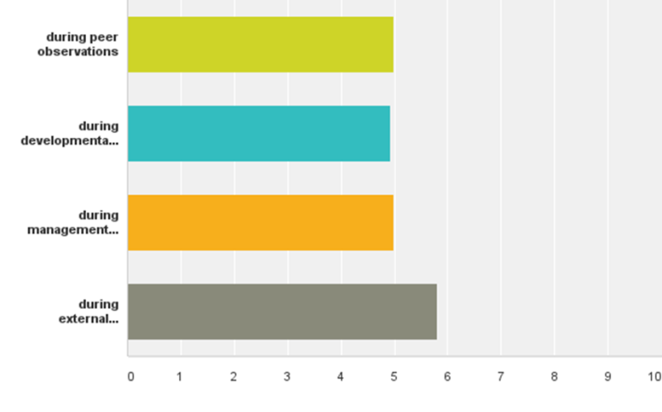
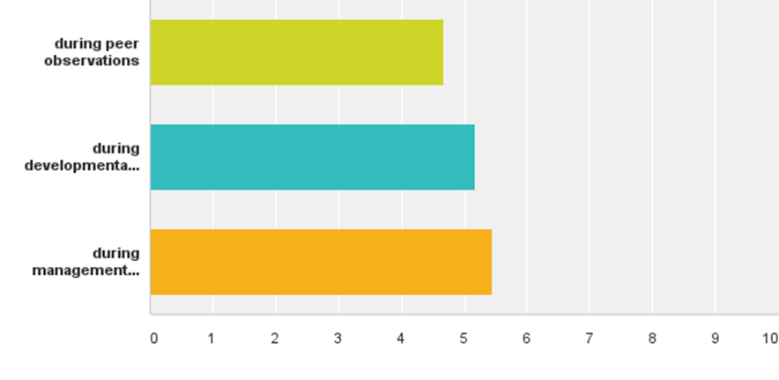
Preliminary Results after 3 cycles of observations
Q4: On a scale of 1 (not comfortable at all) to 5 (very comfortable), grade how comfortable you felt being observed.
Q5: On a scale of 1 (not comfortable at all) to 5 (very comfortable), grade how comfortable you felt observing another teacher:

Slide 7

Suggestions for improvement development team
Lesson planning Task setup Checking for understanding Grammar/vocab presentation
Lesson planning Range of activites Checking understanding
Giving instructions Lessons plans Work on pronunciation
Time limit for activities Dealing with late students Teacher instructions

Slide 8
Suggestions for improvement
Timing: observe mid-trimester
Revise assessment scale
Improve quality of feedback: training? Selection of observers?
Clarify role of observer
Design follow-up procedure after observation feedback has been given
Define in writing what the minimum standards of a “good” language class are
Lesson planning
Checking understanding
Giving instructions

Slide 9

Discussion
What should we maintain no matter what?
What must be changed no matter what?

Slide 10

Bibliography
Bell, M. (2001) Supported Reflective Practice: a programme of peer observation and feedback for academic teaching development. International Journal for Academic Development, 6 (1), 29-39.
Montgomery, D. (2002). Helping Teachers Develop Through Classroom Observation. David Fulton Publishers ltd. London.
Richards, J., and Farrel, T. (2005). Professional Development for Language Teachers: Strategies for teacher learning. Cambridge: Cambridge University Press.
Wajnryb, R. (1992). Classroom Observation Tasks. A resource book for language teachers and trainers. Cambridge University Press.
Tilbury, Alex. (2005) Peer Observation, professional development tasks. Cambridge University Press

Slide 11
Some sites of interest
http://www.aitsl.edu.au/professional-growth/support/classroom-observation-strategies
http://www.ascd.org/publications/educational-leadership/may14/vol71/num08/Rethinking-Classroom-Observation.aspx
http://educationnext.org/getting-classroom-observations-right/
http://curry.virginia.edu/resource-library/practitioners-guide-to-classroom-observations

